Slide 1

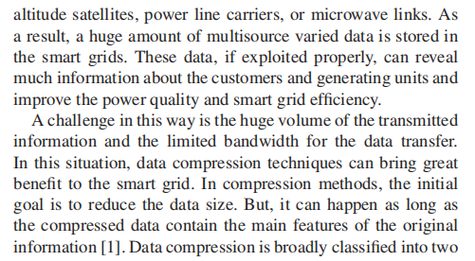
Data in smart grids
PAGE 13

Slide 2
other methods
WD -Originally known as Optimal Subband Tree Structuring -
DCT - is a technique applied to image pixels in spatial domain in order to transform them into a frequency domain in which redundancy can be identified.
Fuzzy-based method - a mathematical system that analyzes analog input values in terms of logical variables
NN - a series of algorithms that endeavors to recognize underlying relationships in a set of data through a process that mimics the way the human brain operates.
Deep stacked autoencoders - a neural network consist several layers of sparse autoencoders where output of each hidden layer is connected to the input of the successive hidden layer.
SVD - a factorization of that matrix into three matrices.
PAGE 14

Slide 3

SVD Form of a matrix
PAGE 15

Slide 4
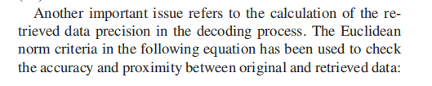
Chicking the accuracy and proximity
PAGE 19

Slide 5
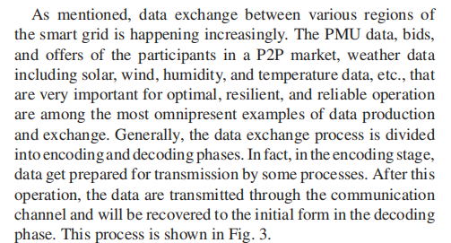
The magic behind - Phasor Measurement Units(PMU)
PAGE 20

Slide 6
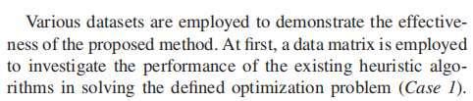
numerical results
PAGE 22

Slide 7
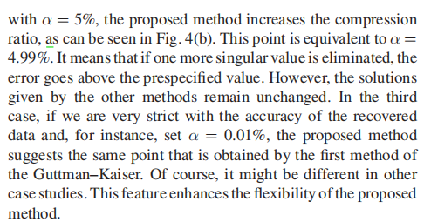
Chart Results
PAGE 24

Slide 8
Guttman Kaiser & De Souza
guttman Kaiser &De Souza proved to be the best on image compression and My proposed method is effective on data compression more ,which is the main theme of this paper.
This is an interesting question , the value may vary , its so hard to estimate the value using this method like currently but i will look further on that , thank you for asking.

